Slide 1
Graphics in Java
Taraneh Seyed
Computer Science Department
SCSU

Slide 2
Overview (JFC)JAVA Foundation Classes
Main elements of Graphical User Interface (GUI)
Overview of JFC
Abstract Windowing Toolkit (AWT)
Swing

Slide 3
GUI
Modern operating systems include presentation services that provide the user with graphical presentation of options and results
Users expect and demand application programs with GUI
JAVA platform provides extensive support for building GUI
A large portion of GUI application is the code to support the GUI interface

Slide 4
Command Line programming
Command line programs are batch programs
Input flows to program, program processes the input and produces the output
Input
Program
Output
Direct communication with user is rare

Slide 5
Menu Driven programming
Non-GUI programs can be in constant communication with user through a menu of options ( in text format)
Open file
Process
Close file
Exit
Output
Program
Communication continues until user selects to EXIT, then program ends itself

Slide 6
Event Driven Programming
Menu driven text based programming is the simplest form of event driven programming
Events are user key strokes and selections from the list of menu items provided by the program
Program waits for an event (to be triggered by user, pressing of 1, 2, 3, 4)
Program recognizes the event (if exit, ends the execution)
Program handles the event (executes the requested action)
Program goes to step 3

Slide 7
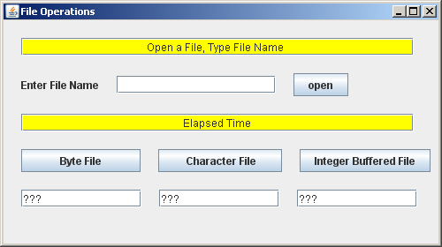
GUI programming
GUI programs are in constant communication with user through GUI components (menu items, toolbar icons,….)
Program
Communication continues until user selects to EXIT, then program ends itself

Slide 8
Event Handlers
GUI programs respond to events (mouse clicked, button selected,…
They need to handle events (recognize it correctly and perform the action requested accordingly)
Display the Output (repaint the screen)
Program
Event handlers
Mouse
{……..}
Button
{……..}
Menu item
{……..}
..

Slide 9
JAVA Swing
The Swing toolkit includes a rich set of components for building GUIs and adding interactivity to Java applications.
Swing includes all the components you would expect from a modern toolkit:
Buttons
Labels
Table controls
List controls
Tree controls

Slide 10
JFC (JAVA Foundation Classes)
JFC is short for Java Foundation Classes
It encompass a group of features for:
Building graphical user interfaces (GUIs)
Adding rich graphics functionality
Adding interactivity to Java applications.

Slide 11
Swing GUI Components
Includes everything from buttons to split panes to tables
Many components are capable of sorting, printing, and drag and drop

Slide 12
Pluggable Look-and-Feel Support
The look and feel of Swing applications is pluggable, allowing a choice of look and feel
The same program can use either the Java or the Windows look and feel
Additionally, the Java platform supports the GTK+ look and feel, which makes hundreds of existing look and feels available to Swing programs

Slide 13
Accessibility API
Enables assistive technologies, such as screen readers and Braille displays, to get information from the user interface.

Slide 14
Java 2D API
Enables developers to easily incorporate:
High-quality 2D graphics
Text
Images
Java 2D includes extensive APIs for generating and sending high-quality output to printing devices

Slide 15
Internationalization
Allows developers to build applications that can interact with users worldwide in their own languages and cultural conventions.
With the input method framework developers can build applications that accept text in languages that use thousands of different characters, such as Japanese, Chinese, or Korean.

Slide 16
Swing Packages
The Swing API is powerful, flexible — and immense. The Swing API has 18 public packages:
javax.accessibility javax.swing.plaf javax.swing.text javax.swing javax.swing.plaf.basic javax.swing.text.html | javax.swing.border javax.swing.plaf.metal javax.swing.text.html.parser javax.swing.colorchooser javax.swing.plaf.multi javax.swing.text.rtf | javax.swing.event javax.swing.plaf.synth javax.swing.tree javax.swing.filechooser javax.swing.table javax.swing.undo

Slide 17
Swing Components
Primary elements of GUI programming from frame window to menu bar, scrollbar, buttons,…
There are two types of components:
Containers --- hold other components
Regular components --- have to be placed in a container

Slide 18
JAVA GUI Containers
To appear onscreen, every GUI component must be part of a containment hierarchy.
A containment hierarchy is a tree of components that has a top-level container as its root.
Swing provides three generally useful top-level container (a component that holds other components) classes:
Jframe
Jdialog
JApplet

Slide 19
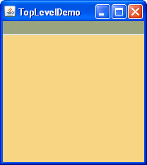
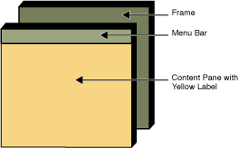
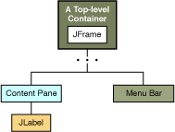
Example

Slide 20
Top-Level Containers and Containment Hierarchies
Each program that uses Swing components has at least one top-level container.
This top-level container is the root of a containment hierarchy — the hierarchy that contains all of the Swing components that appear inside the top-level container.

Slide 21
Example
As a rule, a standalone application with a Swing-based GUI has at least one containment hierarchy with a JFrame as its root.
For example, if an application has one main window and two dialogs, then the application has three containment hierarchies, and thus three top-level containers.
One containment hierarchy has a JFrame as its root, and each of the other two has a JDialog object as its root.

Slide 22
Example
A Swing-based applet has at least one containment hierarchy, exactly one of which is rooted by a JApplet object.
For example, an applet that brings up a dialog has two containment hierarchies.
The components in the browser window are in a containment hierarchy rooted by a JApplet object.
The dialog has a containment hierarchy rooted by a JDialog object.

Slide 23
JDialog Class Hierarchy
Package: javax.swing
Class: JDialog
java.lang.Object
java.awt.Component
java.awt.Container
java.awt.Window
java.awt.Dialog
javax.swing.JDialog

Slide 24
Object Class
Package: java.lang Class: Object
java.lang.Object public class Object
Class Object is the root of the class hierarchy.
Every class has Object as a superclass.
All objects, including arrays, implement the methods of this class.

Slide 25
Component Class
A component is an object having a graphical representation that can be displayed on the screen and that can interact with the user.
Package: java.awt Class: Component
java.lang.Object
java.awt.Component
Direct Known Subclasses: Button, Canvas, Checkbox, Choice, Container, Label, List, Scrollbar, TextComponent

Slide 26
Container Class
Package: java.awt Class: Container
java.lang.Object
java.awt.Component
java.awt.Container
A generic Abstract Window Toolkit(AWT) container object is a component that can contain other AWT components.
Components added to a container are tracked in a list.
The order of the list will define the components' front-to-back stacking order within the container.
If no index is specified when adding a component to a container, it will be added to the end of the list (and hence to the bottom of the stacking order).

Slide 27
Window Class
Package: java.awt Class: Window
java.lang.Object
java.awt.Component
java.awt.Container
java.awt.Window
Direct Known Subclasses: BasicToolBarUI.DragWindow, Dialog, Frame, JWindow

Slide 28
Window Class
A Window object is a top-level window with no borders and no menubar.
A window must have either a frame, dialog, or another window defined as its owner when it's constructed.
The location and size of top-level windows (including Windows, Frames, and Dialogs) are under the control of the desktop's window management system.

Slide 29
Dialog Class
Package: java.awt Class: Dialog
java.lang.Object
java.awt.Component
java.awt.Container
java.awt.Window
java.awt.Dialog
Direct Known Subclasses: FileDialog, JDialog

Slide 30
Dialog Class
A Dialog is a top-level window with a title and a border that is typically used to take some form of input from the user.
The size of the dialog includes any area designated for the border.

Slide 31
JDialog Class
Package: javax.swing Class: JDialog
java.lang.Object
java.awt.Component
java.awt.Container
java.awt.Window java.awt.Dialog
javax.swing.JDialog

Slide 32
JDialog Class
The main class for creating a dialog window. You can use this class to create a custom dialog, or invoke the many class methods in JOptionPane to create a variety of standard dialogs.
For information about creating dialogs, see The Java Tutorial section How to Make Dialogs.

Slide 33
Frame Class
Package: java.awt Class: Frame
java.lang.Object
java.awt.Component
java.awt.Container
java.awt.Window
java.awt.Frame
Direct Known Subclasses: JFrame

Slide 34
Frame Class
A Frame is a top-level window with a title and a border.
The size of the frame includes any area designated for the border.
The dimensions of the border area may be obtained using the getInsets method
Since the border area is included in the overall size of the frame, the border effectively obscures a portion of the frame, constraining the area available for rendering and/or displaying subcomponents.

Slide 35
JFrame Class
Package: javax.swing Class: JFrame
java.lang.Object
java.awt.Component
java.awt.Container
java.awt.Window
java.awt.Frame
javax.swing.Jframe
You can find task-oriented documentation about using JFrame in The Java Tutorial, in the section How to Make Frames.

Slide 36
JApplet Class
Package: javax.swing Class: JApplet
java.lang.Object
java.awt.Component
java.awt.Container
java.awt.Panel
java.applet.Applet
javax.swing.JApplet

Slide 37
Container Classes
Three important container classes are:
JDialog
JFrame
JApplet

Slide 38
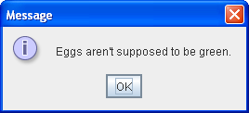
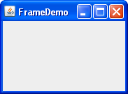
Class Hierarchy of Container Classes
Object
Component
Container
Window
Panel
Dialog
Frame
Applet
JDialog
JFrame
JApplet

Slide 39
Window Specifications
A graphics window is drawn using pixels
A pixel is a colored dot
Windows system uses RGB (Red, Green, Blue) system to create colors
Each component may represent 256 shades of red/green/blue by combing them into a composite color

Slide 40
Window Coordinate System
You may refer to any point on the window (pixel) using its coordinates (X – horizontal coordinate, Y – Vertical coordinate)
X ------ >
Y

Slide 41
Window Coordinate System
Pixel coordinates start at (0,0) for topleft corner of the window and extend to (windowwidth-1) for X and (windowheight-1 ) for Y
X 0 ----------------- ---------- windowwidth-1
Y
0
Windowheight - 1

Slide 42
Elements of GUI Programming
Select a component type
Define the component (in main method)
Initialize the component (in the constructor of the class)
Develop “actionPerformed” method to receive event information and act upon it
Develop “paint()” method to redraw the screen with new information on it

Slide 43
GUI programming Structure
GUI class definition
Main
Define component
Set component attributes
Action Performed
Identify action
Take action accordingly
Repaint()
Constructor
Define controls
Add them to component
Add action listener for them
Paint()
Identify action
paint()

Slide 44
GUI Program Design
You need at least two classes in every program:
A class to create and handle the interface (this class will have the main method in it)
One/more classes to handle the functionality of the program

Slide 45
Example
Develop an interactive program to provide the following options in two menus labeled File and Mathematics. Include the following items in the File menu:
About --- explain what this program is about, input, process, output
Exit --- terminate the program
Include the following items in the Mathematics menu:
Enter Numbers --- prompt user using consecutive dialogue boxes to enter the two integer numbers. Test the string entered to make sure it is a proper integer number.
Add --- display the two numbers and their sum
Subtract --- display the two numbers and their difference
Multiply --- display the two numbers and their product

Slide 46
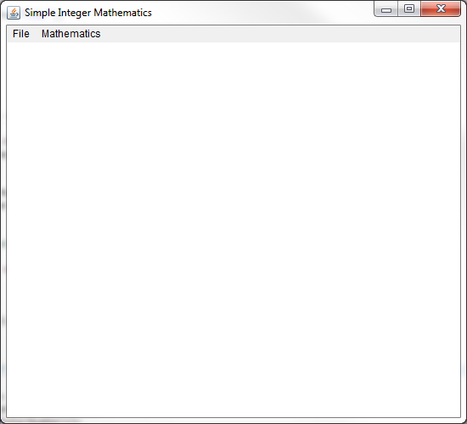
Initial Interface

Slide 47
Class to Define and Handle Interface
Name your class as Project# (# stands for project number 01, 02,…..)
Include all the imports you need to support graphics

Slide 48
GUI Packages (imports)
// GUI-related imports
import java.awt.*;
import java.awt.event.*;
import javax.swing.*;
public class Project00 extends Frame implements ActionListener
{
…..
}

Slide 49
Class definition
Class header
public class Project00 extends Frame implements ActionListener
Extends Frame --- > inherits all functionality of Frame class
Implements ActionListener --- > events are caught through ActionListener

Slide 50
Main method
public static void main(String[] args)
{
// create an object of the Frame class, calls the
//constructor to place the controls on the frame
Frame f = new Project00();
f.setResizable(true);
f.setSize(550,500);
f.setVisible(true);
}

Slide 51
Class Constructor
public Project00()
{
setTitle("Simple Integer Mathematics");
// Create Menu Bar
MenuBar mb = new MenuBar();
setMenuBar(mb);
// Create Menu Group Labeled "File"
Menu fileMenu = new Menu("File");
// Add it to Menu Bar
mb.add(fileMenu);

Slide 52
Add Menu Items
// Create Menu Items
// Add action Listener
// Add to "File" Menu Group
MenuItem miAbout = new MenuItem("About");
miAbout.addActionListener(this);
fileMenu.add(miAbout);
MenuItem miExit = new MenuItem("Exit");
miExit.addActionListener(this);
fileMenu.add(miExit);

Slide 53
Create the Mathematics Menu
Menu mathematicsMenu = new Menu("Mathematics");
// Add it to Menu Bar
mb.add(mathematicsMenu);
// Create Menu Items
// Add action Listener
// Add to “Mathematics" Menu Group
MenuItem miEnterNumbers = new MenuItem("Enter Numbers");
miEnterNumbers.addActionListener(this);
mathematicsMenu.add(miEnterNumbers);
MenuItem miAdd = new MenuItem("Add");
miAdd.addActionListener(this);
mathematicsMenu.add(miAdd);
// Add the rest of the menu items

Slide 54
Code to ensure proper function of the windows
WindowListener l = new WindowAdapter()
{
public void windowClosing(WindowEvent ev)
{
System.exit(0);
}
public void windowActivated(WindowEvent ev)
{
repaint();
}
public void windowStateChanged(WindowEvent ev)
{
repaint();
}
};
ComponentListener k = new ComponentAdapter()
{
public void componentResized(ComponentEvent e)
{
repaint();
}
};
// register listeners
this.addWindowListener(l);
this.addComponentListener(k);

Slide 55
ActionPerformed Method
//*********************************************
// called by windows manager whenever the
// application window performs an action
// (select a menu item, close, resize, ....)
//
//*********************************************

Slide 56
Create a Class to Handle Functionality of the Program (Mathematics)
import javax.swing.JOptionPane;
public class Mathematics
{
// define data members, constructor and methods to handle the functions
}
Once the class is created, create an object of this class in Project00

Slide 57
Create an Object of Mathematics in Project00
Mathematics t = new Mathematics();

Slide 58
ActionPerformed
public void actionPerformed (ActionEvent ev)
{
// figure out which command was issued
command = ev.getActionCommand();
// take action accordingly

Slide 59
Possible Actions – About/Exit …..
if ("About".equals(command))
{
repaint(); // call paint to display comments
}
else
if("Exit".equals(command))
{
System.exit(0);
}

Slide 60
Possible Actions – Add/Subtract ….
else
if("Enter Numbers".equals(command))
{ // call a method of Mathematics class to get the numbers
t.getNumbers();
}
else
if("Add".equals(command) ||
"Subtract".equals(command) ||
"Multiply".equals(command) ||
"All Operations".equals(command))
{
repaint();
}
}

Slide 61
Paint Method
public void paint(Graphics g)
{
……
}
http://docs.oracle.com/javase/1.4.2/docs/api/java/awt/Graphics.html
Use graphics class methods to place text on the window
Note --- numbers should be converted to text before they can be placed on the drawing window

Slide 62
Paint Method
// called by repaint() or any action on the windows to redraw the screen
public void paint(Graphics g)
{
int x; // define a starting point for X and Y
int y;
if ("About".equals(command))
{ // Display comments on what this program is about
// there might be many lines of comments
// define them in an array of strings and display them from there
}

Slide 63
Defining the Comments About the Program
// program description displayed in About menu
String[] description = new String[]
{
" This program receives two integer numbers and calculates",
" and Displays the sum, difference and product of the numbers entered",
" Input:",
" - Two integer numbers ",
" Output:",
" - sum, difference and product of input numbers"
};
Add it as a global variable to Project00

Slide 64
Back to Paint to Display the Comments
if ("About".equals(command))
{
x = 100;
y = 200;
for (int i=0; i<6; i++)
{
// display the string, increment Y
g.drawString(description[i],x,y);
y=y+25;
}
}

Slide 65
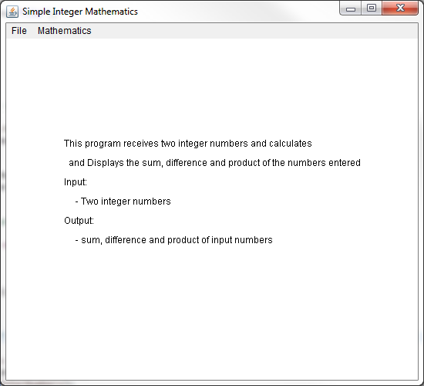
Result

Slide 66
Develop Mathematics Class
private int first,second;
private int sum,difference,product;
public Mathematics()
{
first = second = 0;
sum = difference = product = 0;
}

Slide 67
getNumbers Method
public void getNumbers()
{
// get the first number
String input = JOptionPane.showInputDialog(null, "Please enter an integer:",
"Enter the First Number",JOptionPane.QUESTION_MESSAGE);
first = Integer.parseInt(input);
// get the first number
input = JOptionPane.showInputDialog(null, "Please enter an integer:",
"Enter the Second Number", JOptionPane.QUESTION_MESSAGE);
second = Integer.parseInt(input);
// call the methods to calculate the sum, difference and product
setSum();
setDifference();
setProduct();
}

Slide 68
get and set Methods
Since data members of your class are private define two method for each, set method to calculate the value, get method to make it available to users
private void setSum()
{
sum = first+second;
}
public int getSum()
{
return sum;
}

Slide 69
Finish paint Method
if("Enter Numbers".equals(command))
{
x = 200;
y = 200;
g.drawString("The Two numbers entered are:",x,y);
y=y+25;
g.drawLine(x-50,y,x+200,y);
y=y+25;
g.drawString("First Number" ,x,y);
g.drawString(" = "+Integer.toString(t.getFirst()),x+100,y);
y = y+25;
g.drawString("SecondNumber" ,x,y);
g.drawString(" = "+Integer.toString(t.getSecond()),x+100,y);
y = y+25;
}

Slide 70
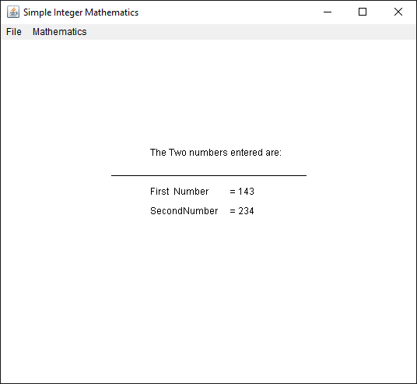
Result

Slide 71
Paint
else
if("Add".equals(command))
{
x = 250;
y = 220; g.drawString(Integer.toString(t.getFirst())+" +",x,y);
y=y+25;
g.drawString(Integer.toString(t.getSecond()),x,y);
y=y+15;
g.drawLine(x-20,y,x+40,y);
y=y+25;
g.drawString(Integer.toString(t.getSum()),x,y);
}

Slide 72
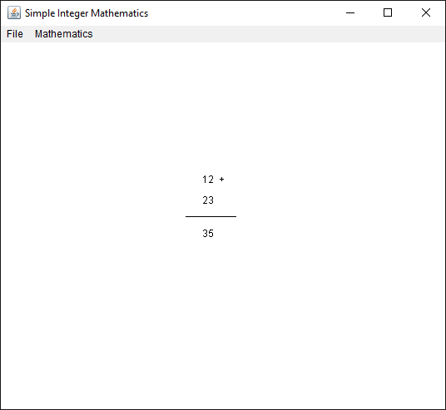
Result

Slide 73
References
http://java.sun.com/docs/books/tutorial/reallybigindex.html
http://java.sun.com/docs/books/tutorial/ui/index.html
http://java.sun.com/docs/books/tutorial/ui/features/components.html
http://java.sun.com/docs/books/tutorial/uiswing/components/index.html

